Slide 1
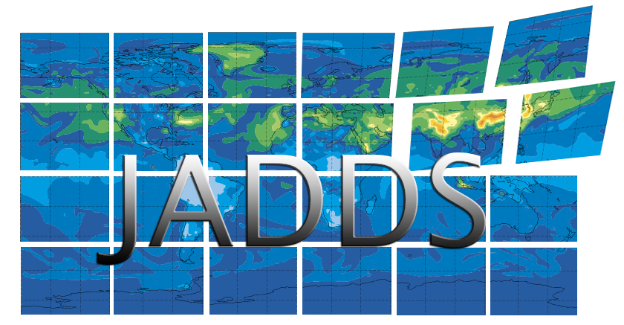
JADDS & EUDAT Collaboration

Slide 2
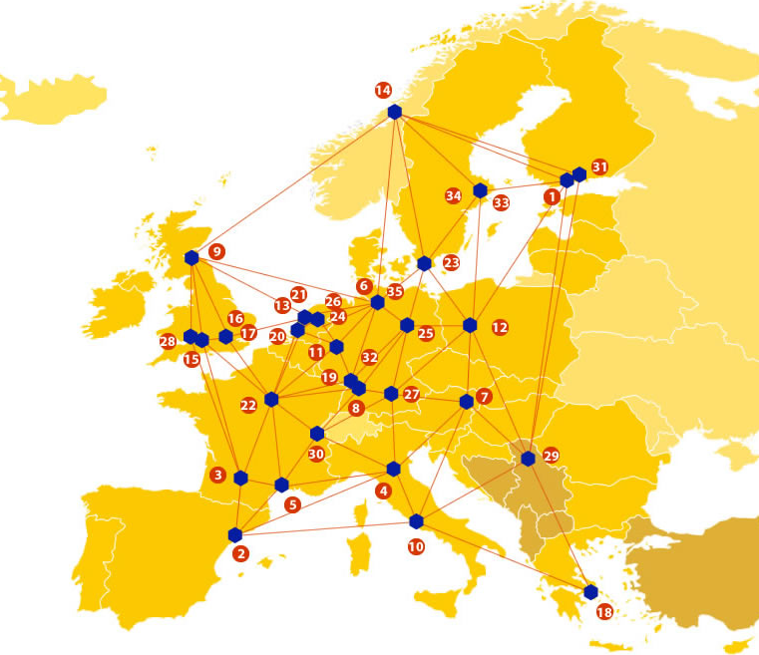
EUDAT: A truly pan-European Infrastructure
EUDAT offers common data services to both research communities and individuals through a network of 35 European organisations.
EUDAT wants to enable European researchers from any discipline to preserve, find, access, and process data in a trusted environment, as part of a Collaborative Data Infrastructure.
European infrastructures
Technology Providers
Research Communities

Slide 3
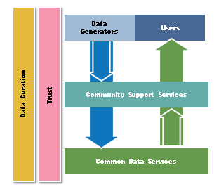
EUDAT Vision & Mission
Vision: Data is shared and preserved across borders and disciplines thereby enhancing the value and quality of research at large.
Mission: To enable data stewardship within and between European Research Communities through a Collaborative Data Infrastructure, a common model and service infrastructure for managing data spanning all European research data centres and community data repositories.

Slide 4
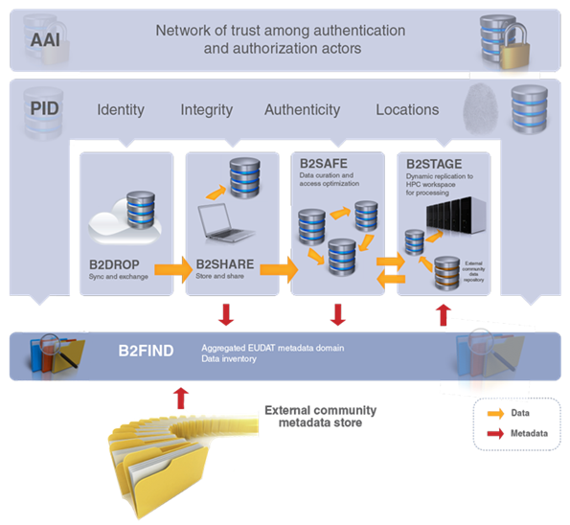
B2 Service Suite
Covering both access and deposit, from informal data sharing to long-term archiving, and addressing identification, discoverability and computability of both long-tail and big data, EUDAT services seek to address the full lifecycle of research data
https://www.eudat.eu/services
Notes:
B2FIND
stores metadata as well through other EUDAT services such as B2SHARE to provide access to data object within the EUDAT CDI
is used in inter-service use cases, e.g. to select links to data to be transferred to HPC platforms through B2STAGE

Slide 5
Building solutions with the communities
EUDAT services (B2 Service Suite) are designed, built and implemented together with user communites.
Common Language Resources and Technology Infrastructure (CLARIN)
European Network for Earth System Modelling (ENES)
Distributed infrastructure for life-science information (ELIXIR)
European Plate Observing System (EPOS) - Solid Earth sciences Research Infrastructure
Integrated Carbon Observation System (ICOS) to quantify & understand greenhouse gas balance
Long-Term Ecosystem Research (LTER) in Europe

Slide 6
Pilot Overview
Global model data of atmospheric composition produced by the Copernicus Atmospheric Monitoring Service (CAMS) is collected since 2010 and serves as boundary condition for use by regional air quality modellers world-wide.
An existing Web Coverage Service (WCS) for sharing these individually tailored model results shall be re-engineered to make use of a modern, scalable database technology in order to improve performance, enhance flexibility, and allow the operation of catalogue services.
The WCS protocol shall be upgraded to WCS2.0 and the metadata shall be interfaced with the EUDAT service structure.

Slide 7
The Challenge
An existing server lacks the performance required. The service is limited by the server hardware and by the file-based data storage
The outdated WCS version prevents automatic harvesting of metadata for web catalogue services such as those offered by B2FIND
Storage capacity on the existing server is limited and long-time support is not fully ensured

Slide 8
EUDAT Service Uptake
Multi-disciplinary joint metadata catalogue - The outdated WCS version prevents automatic harvesting of metadata for web catalogue services such as those offered by B2FIND. The WCS 2.0 service shall be harvested by the EUDAT B2FIND service.
Repository for shareable digital objects - Selected data products that are frequently requested shall be stored in B2SHARE and made available in the WCS infrastructure and through the JOIN web interface. In addition users of JOIN have the opportunity to store their data selections with a PID in B2SHARE for referencing them in publications.

Slide 9
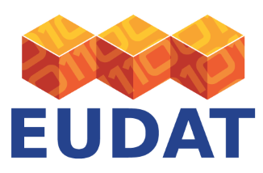
Contact
EUDAT
Web – eudat.eu
Twitter - @EUDAT_EU
O. Stein
Research Centre Jülich, Germany
o.stein@fz-juelich.de

